Slide 1
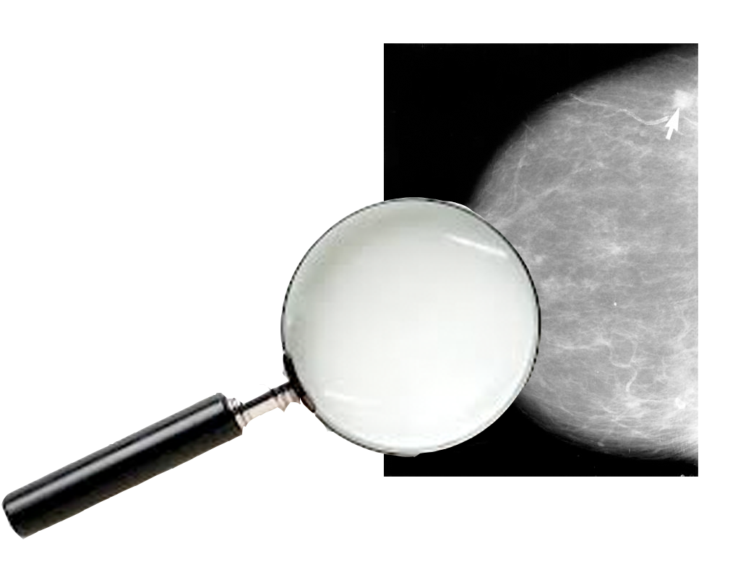
Cancer
Lesson 5.2
What do cancer screens really tell us?

Slide 2
Do Now
What challenge did the journalist you read about in yesterday’s homework face?
What would an ideal screening test look like?

Slide 3
An ideal screening test
An ideal screening test would:
detect everyone who has a tumor, and needs treating for it, and no-one who:
has a tumor and doesn’t need treating
doesn’t have a tumor.

Slide 4
Sensitivity and specificity
Sensitivity: How well the screen detects people who have the disease.
Specificity: How well the screen distinguishes people who are disease-free.
Notes:
For example, a sensitivity of 80% means that for every ten participants with the disease, eight will test positive and the other two will be false negatives. A test with poor sensitivity results in a high proportion of the population with the disease escaping detection. These people will be falsely reassured and could delay presenting important symptoms.

Slide 5
Screens: sensitivity and specificity
Healthy
Diseased

Slide 6
Screen 1 – sensitivity problem
Healthy
Population
Diseased
Screen 1
 | Population
Healthy | 6/10 = 60%
Diseased | 4/10 = 40%
 | Screen 1 Results
False + | 3/6 = 50%
False – | 0%
30% of people may get treatment they don’t need!

Slide 7
Screen 2 – specificity problem
Healthy
Population
Diseased
Screen 2
 | Population
Healthy | 60%
Diseased | 40%
 | Screen 2 Results
False + | 0%
False – | 50%
20% of people have disease but don’t know!
Notes:
In a general population, it is difficult to know who is diseased and who is healthy. A test that is highly specific (TEST 1) is going to accurately predict individuals who have diseases, but may miss some of the diseased people who can’t be identified using the test (producing false negatives). However, a test that his highly sensitive is going to pick up everyone who has the disease, but may also identify healthy individuals as being diseased (producing false positives).

Slide 8
False positives and false negatives
False positive: Someone diagnosed with a disease who’s healthy.
False negative: Someone with a disease who’s diagnosed as healthy.
Notes:
It is usually difficult to achieve this as there is a trade off between the two measures; tightening the criteria for one results in a decrease in the other.

Slide 9
Why false positives and negatives are a problem
False negatives: People who are sick may not get treatment.
False positives: People may undergo unnecessary treatment causing painful and traumatic side effects.
This is called overdiagnosis.
Notes:
It is usually difficult to achieve this as there is a trade off between the two measures; tightening the criteria for one results in a decrease in the other.

Slide 10
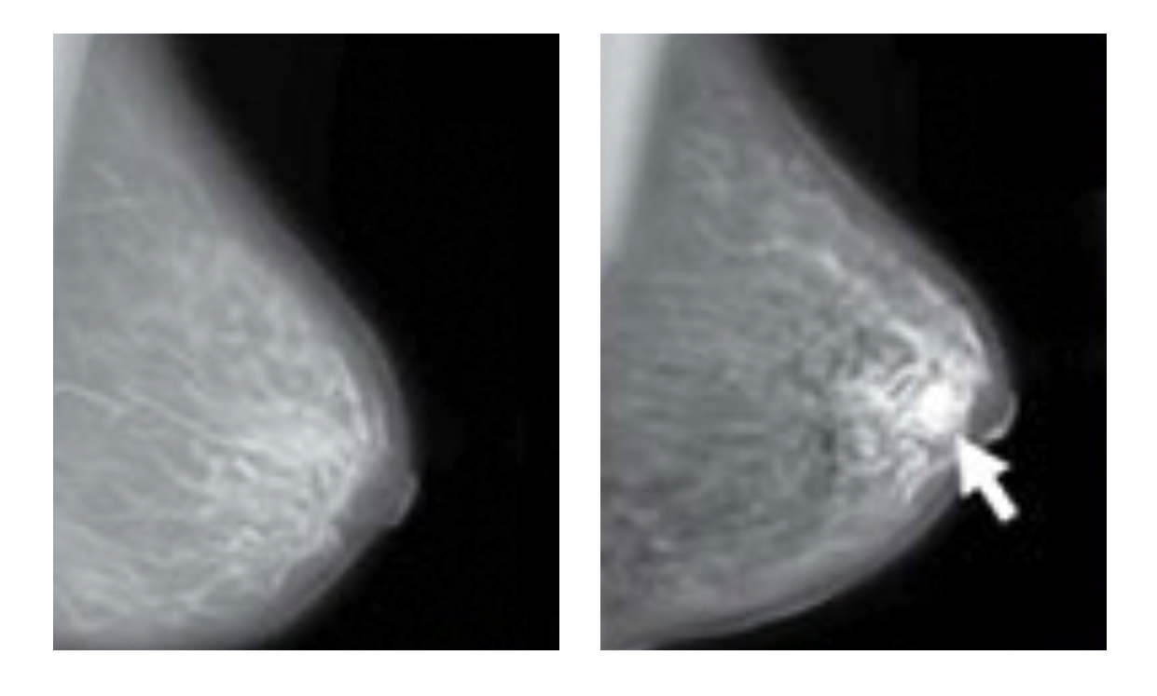
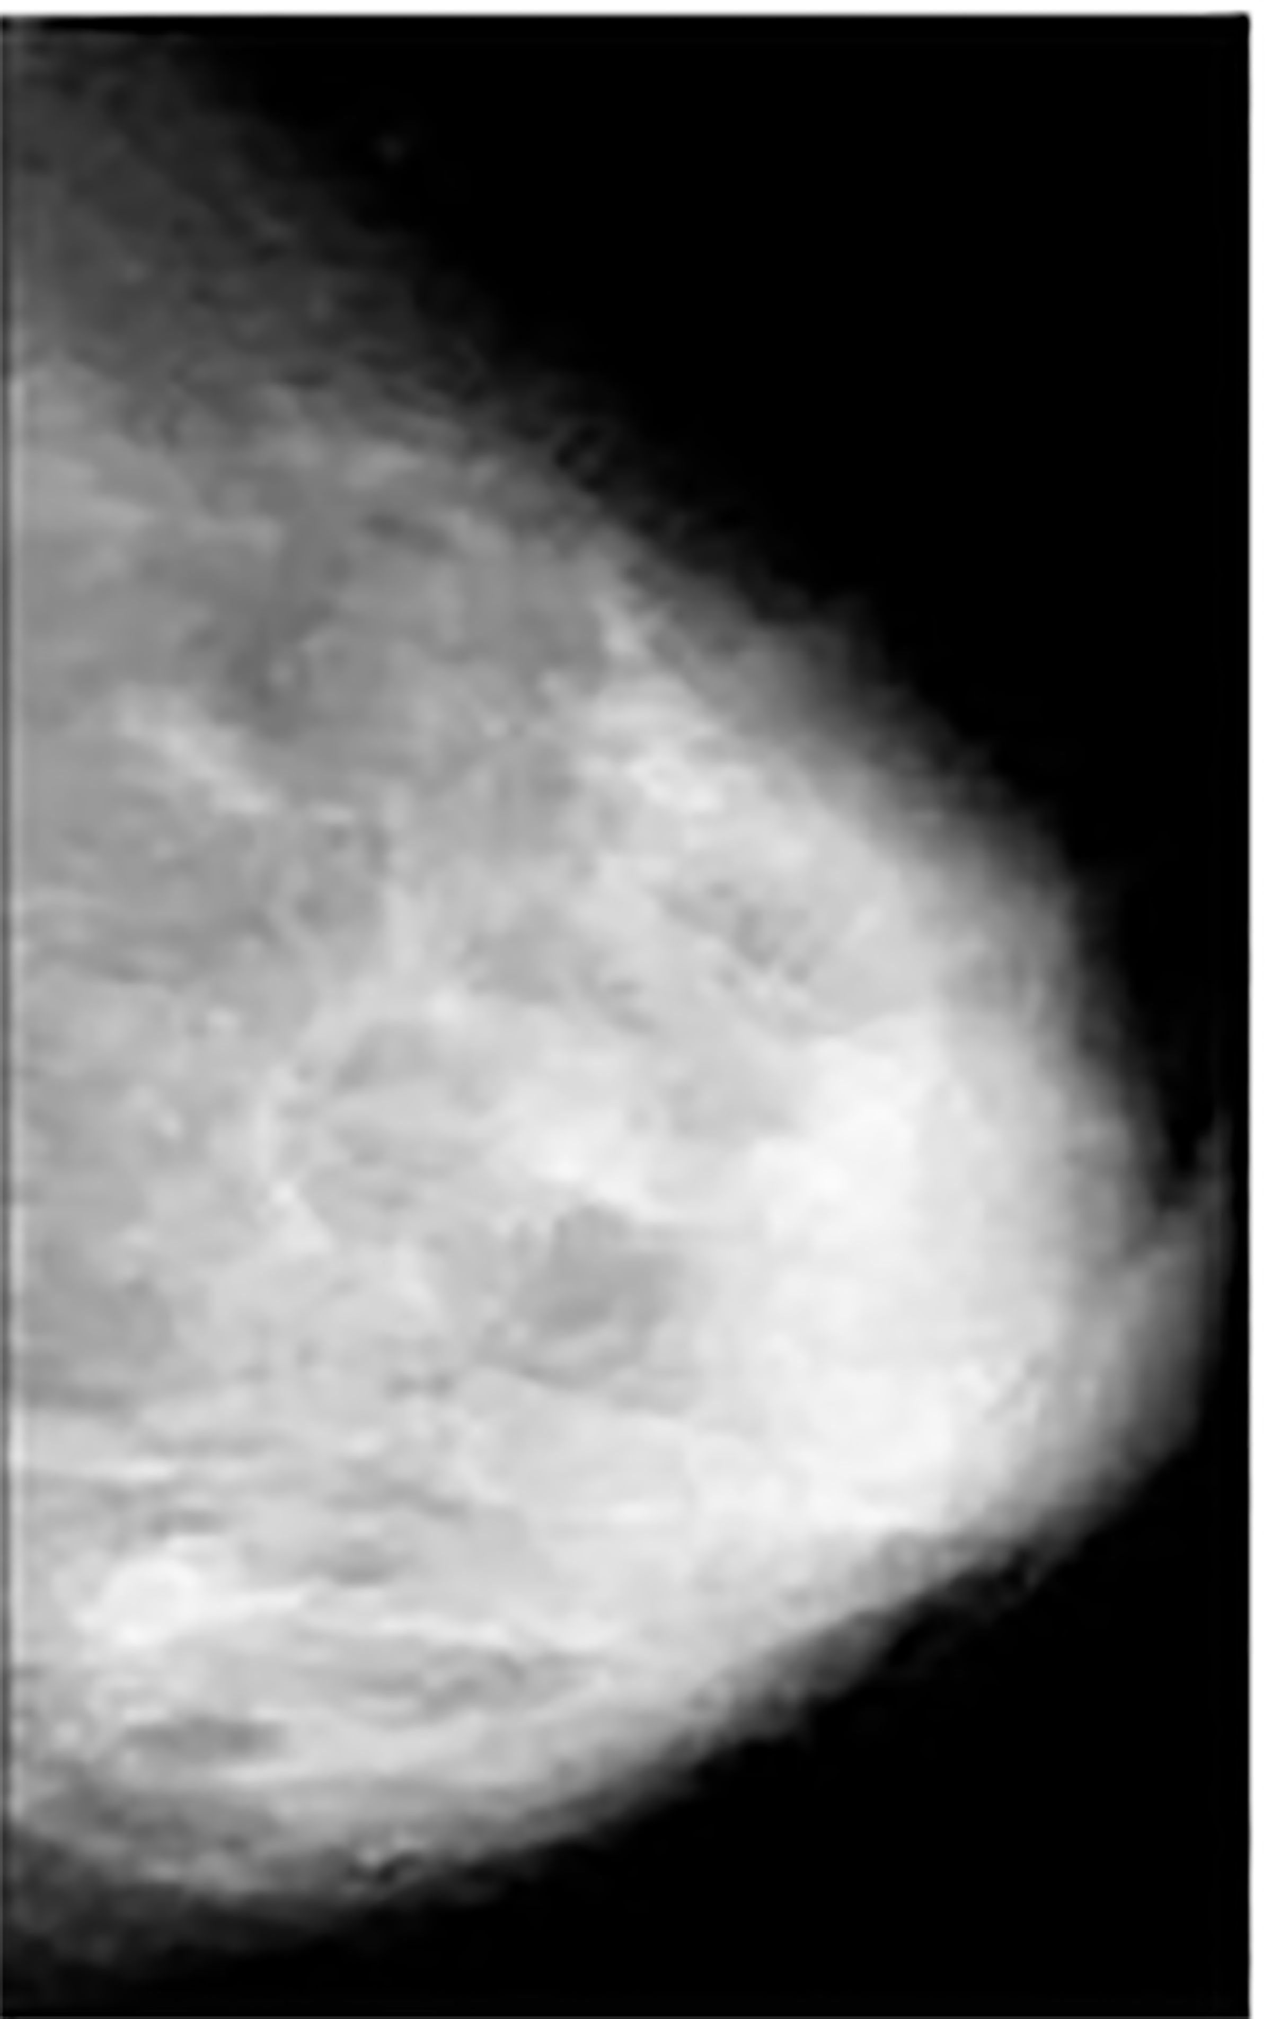
False positives with imaging screens - mammography
Cyst
Benign tumor or
Malignant tumor
Normal
breast
Normal dense
breast

Slide 11
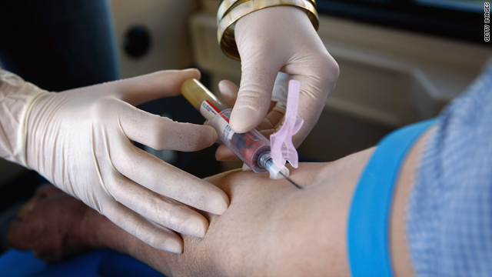
False positives with blood tests- PSA
The Prostate Specific Antigen (PSA) screen measures the blood levels of a protein produced by the prostate.
Prostate cancer cells
make more PSA than
normal prostate cells.
But prostate cells that are
damaged but not cancerous
also make more PSA than normal.
Notes:
It is usually difficult to achieve this as there is a trade off between the two measures; tightening the criteria for one results in a decrease in the other.
Many people may naturally make more PSA that gets secreted in the blood, which is why they will test positive for prostate cancer by this screen, but be perfectly healthy. Like with imaging,

Slide 12
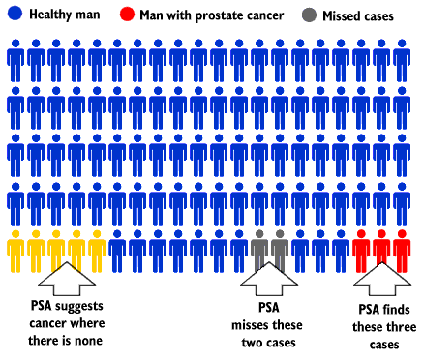
Problems with chemical screens - PSA
www.health.gov.on.ca

Slide 13
Overdiagnosis - PSA
Prostate cancer is slow growing and men usually die with it rather than of it.
False positives often get unnecessary treatment with very bad side effects.

Slide 14
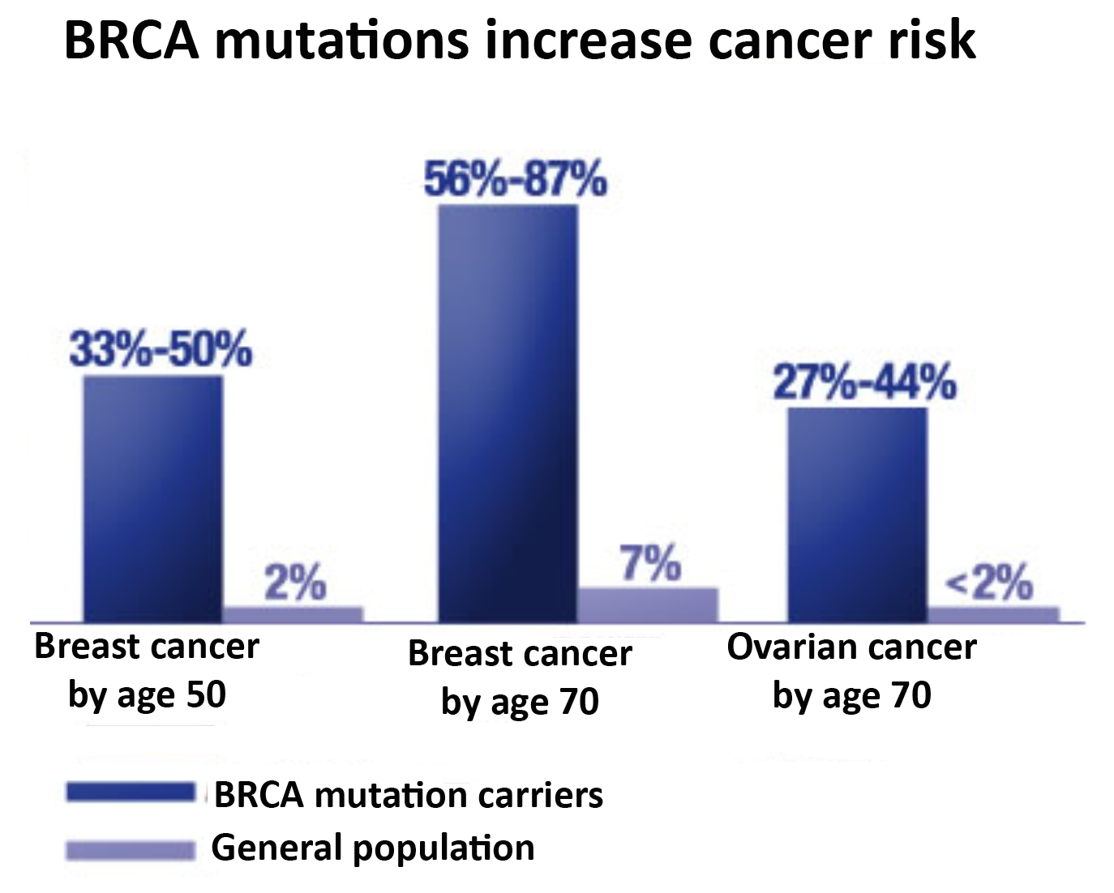
BRCA Genetic Test
DNA obtained from a cheek swab is used to identify genetic mutations in the BRCA1 gene.
Notes:
Not all positive results of the screen will lead to aggressive breast cancer, though some positive results will. Similarly, just because you don’t have a BRCA germline mutation does not mean that you might not get a BRCA somatic mutation. So, the test is specific, though not very sensitive.
Not all genetic mutations are the same. Some BRCA mutations may have minimal increased risk, while others may have very high increased risk. It is important to weigh the risk of developing disease against the cost/side effects that the disease exhibits.

Slide 15
Genetic mutations
Inherited mutations: Are found in sperm and egg cells.
They are called germline mutations.
Non-inherited mutations: Are found in the tumor.
They are called somatic mutations.
Notes:
Not all positive results of the screen will lead to aggressive breast cancer, though some positive results will. Similarly, just because you don’t have a BRCA germline mutation does not mean that you might not get a BRCA somatic mutation. So, the test is specific, though not very sensitive.
Not all genetic mutations are the same. Some BRCA mutations may have minimal increased risk, while others may have very high increased risk. It is important to weigh the risk of developing disease against the cost/side effects that the disease exhibits.

Slide 16
Activity
Divide into groups of three and discuss overdiagnosis in the context of liver cancer and sarcomas.
Use the worksheet to evaluate the utility of the screens for liver cancer and sarcomas.

Slide 17
Wrap up
What do mammograms and PSA tests have in common with the liver cancer and sarcoma screens?
What is another major problem with interpreting the results of screens?

Slide 18
Wrap up
Which should drive screening guidelines – population statistics or individual experiences?
Where is the cost of an ineffective screen?

Slide 19
Homework
Review the two-page information sheets for tomorrow’s lesson

